Slide 1
Uninformed Search
Chapter 3

Slide 2
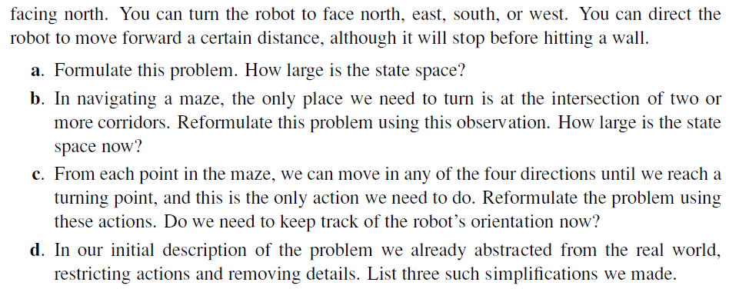
Notes:
A.
Initial State: (x_{o}, y_{o}, r_{o}) which represents the initial position and rotation of the robot
Goal Test: (x,y) not inside the maze
Successor Function: Given (x,y,r), the successors are (x,y,0), (x,y,90), (x,y,180), (x,y,270), (x+d*cos(r), y+d*sin(r), r) where d is the certain distance
Cost: 1 per action
To compute the state space size, we divide the space into square of size dxd (where d is the distance traveled in each step). The state space size = number of empty square * 4 possible rotation.
B.
Successor Function: Given (x,y,r), the successor is (x+d*cos(r), y+d*sin(r), r) where d is the certain distance, and if (x,y) is an intersection, add (x,y,0), (x,y,90), (x,y,180), (x,y,270) to the successors
The state space size = (number of empty square - number of intersections) * 2 possible rotations + number of intersections * 4 possible rotations.
C.
Successor Function: Given (x,y,r), the successors are (x,y,0), (x,y,90), (x,y,180), (x,y,270), (x+L*cos(r), y+L*sin(r), r) where L is the distance to the upcoming intersection in direction r
The state space size = number of intersections * 4 possible rotations.
D.
1- The robot will accurately face the requested direction (no rotation error).
2- The robot will accurately move d distance in every action.
3- We discretized the action space.

Slide 3
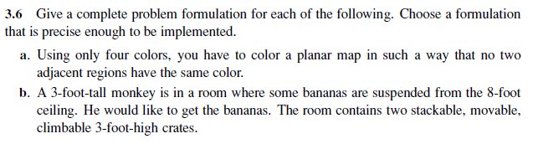
Notes:
Initial state: State = [None, None, .. ] which is a list containing a color for each node in the map
Goal test: State[n] != None for all node n in the map.
Actions: Color(n, c) where n is an uncolored node and c is a color not used by any node adjacent to n.
Transition Model:
Given the state “State”, and Action “Color(n, c)”, the successor “Successor” is defined:
Successor[i]=c if i = n
Successor[i]=State[i] if i != n
Cost function: 1 for each action. If we want to find the color assignment with the least number of used color, we could make the cost for using a new color higher

Slide 4
Notes:
The main idea of the solution:
Initial state: as described in the question.
Goal test: you have banana.
Actions: open any box you have the key for, get the contents of any open box.
Cost function: number of actions.
*** We will solve a similar problem when we get to Classical Planning

Slide 5
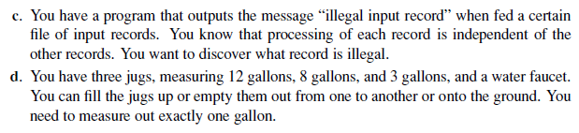
Notes:
Initial state: State = All records are in the suspected list
Goal: Number of records in the suspected list = 1
Action: Send subset S of suspected records to the program
Transition Model:
Given the output of the program to the subset S we send
If result is “illegal input record”:
Successor = S being the new suspected list
Else:
Successor = all the suspected records in “State” except the ones in S
Cost: 1 per action

Slide 6
Notes:
Initial state: Content = [0, 0, 0] (all jugs are empty)
Goal: There exists j where Content[j] = 1
Actions:
Fill jug j from faucet where content[j] < capacity[j]
Empty jug j into jug k where j != k, content[j] >0 and content[k] < capacity[k]
Empty jug j onto the ground where content[j] > 0
Successor:
If action = Empty jug j onto the ground:
newcontent[j] = 0 // jug was emptied
If action = Empty jug j into jug k
amount = min( content[j], capacity[k] - content[k] )
newcontent[j] = content[j] - amount
newcontent[k] = content[k] + amount
If action = Fill jug j from faucet:
newcontent[j] = capacity[j]
Cost: 1 for each action (or 1 + amount of water drawn from faucet to discourage water wasting. We add 1 since we cannot have a cost of 0).

Slide 7
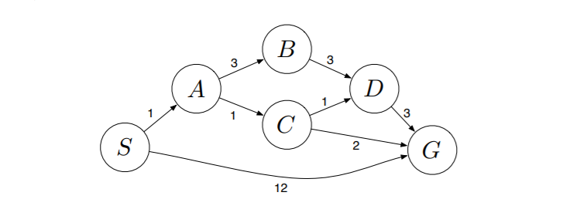
Apply BFS, DFS, and UCS to the following problem:
Notes:
BFS:
Path: S->G
Expansion: S,A,G
DFS:
Path: S->A->B->D->G
Expansion: S, A, B, D, G
UCS:
Path: S->A->C->G
Expansion: S, A, C, D, B, G

